Slide 1


IiT Food Food For Hawks
Android
Team 15
Ankit Malviya
Vivek Sahu
Poojitha
Sharon W

Slide 2
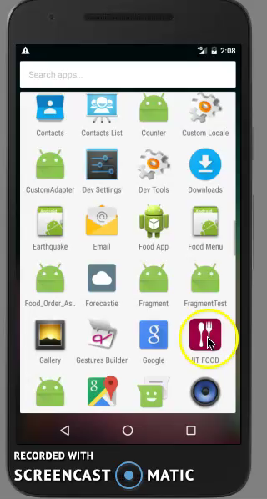
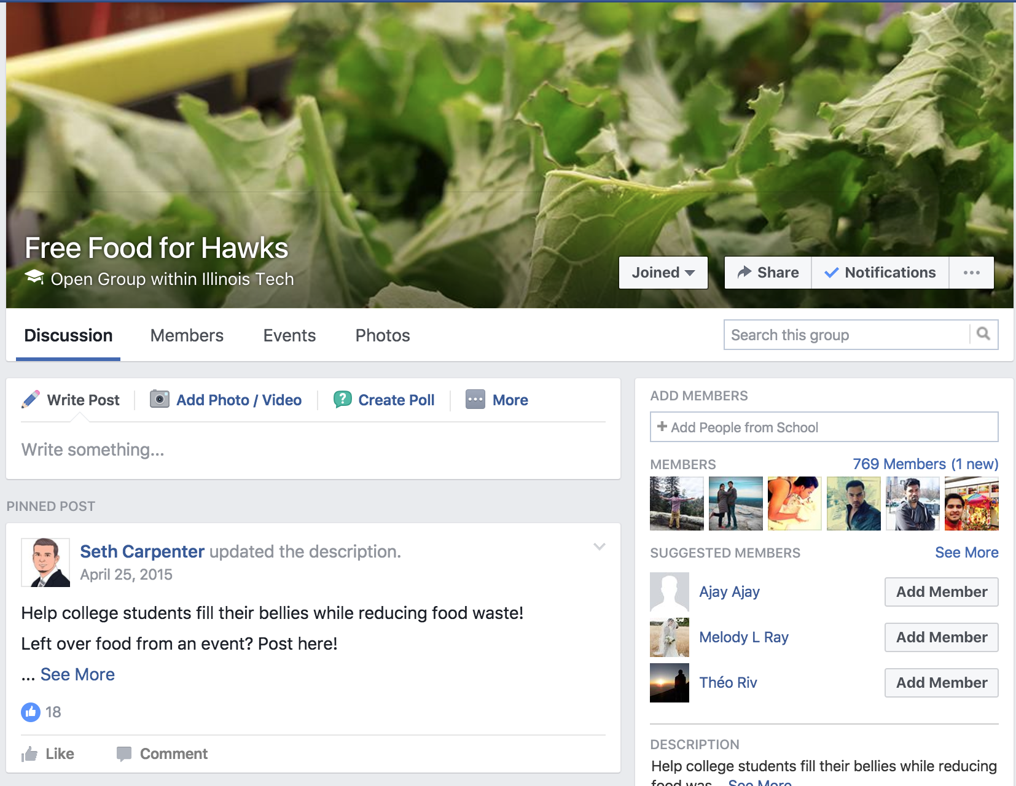
Project Idea
Application for IIT students to share the information about event foods
Idea is to avoid wastage of food and help students

Slide 3

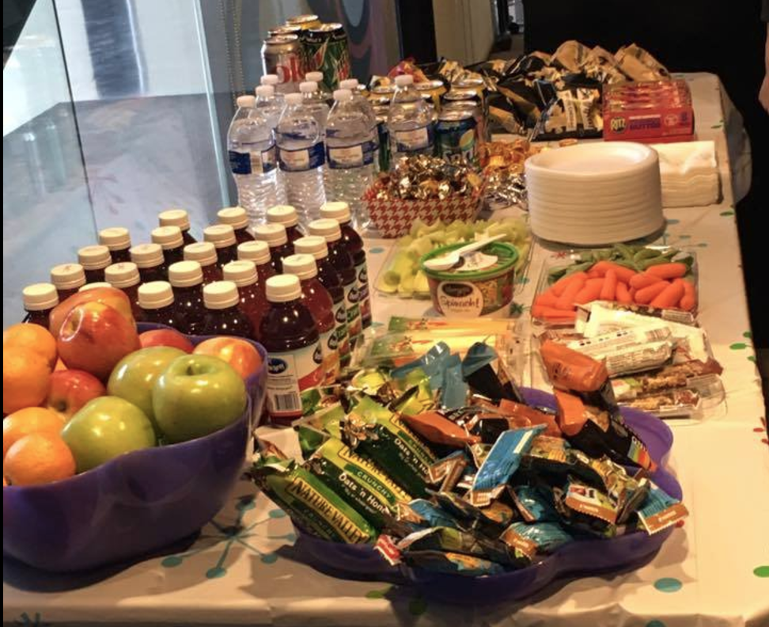
Events @ IIT
Krishna lunch
Guest Speaker Event
Bog night
Festival Celebration

Slide 4
Introduction What IiT food is about?
Post event food details with current picture
Registered users will be notified
Location of event
Reviews about the event food

Slide 5

Statistics Popularity factor
7,762 Student enrollment every year
36% of students live off campus and cook food
66% of graduate students classified as international students
5 per week – Event occurrence in college
Initial target users will be Indian students

Slide 6
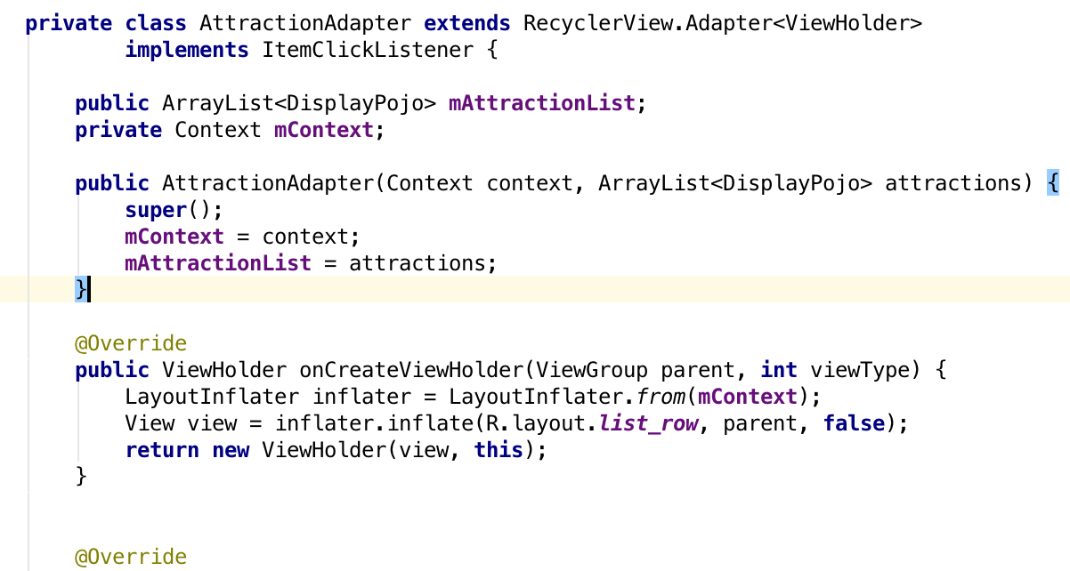
Android Design Pattern
Structural Pattern

Slide 7



Technologies
Google Map
Google Firebase
Amazon AWS

Slide 8

Features
Fragment
UI /Layout
Action Bar
Notification
Animation
Location
Camera
Adapter /Views
Content Provider
Internet /Services
Shared Preference
Pull to refresh

Slide 9
Team Work
Ankit Malviya Data Management Framework Integration UI/Fragment Animation API | Vivek Sahu Shared Preference Action Bar Camera Services UI Customized views
Poojitha Notification Test cases | Sharon Google Map Test cases

Slide 10
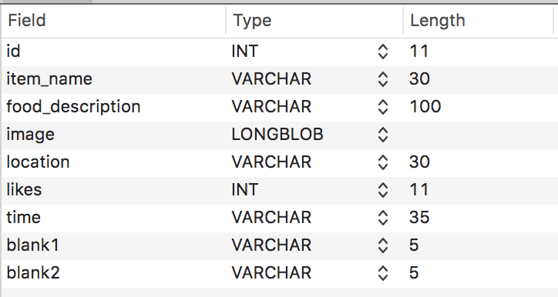
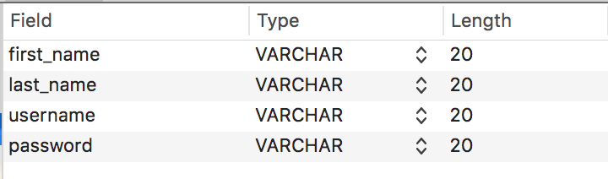
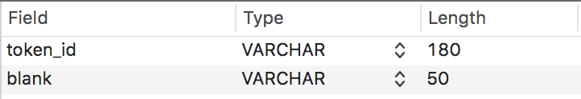
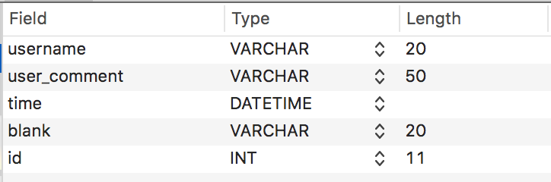
Database Schema
Freefood_post
register
token
comments

Slide 11
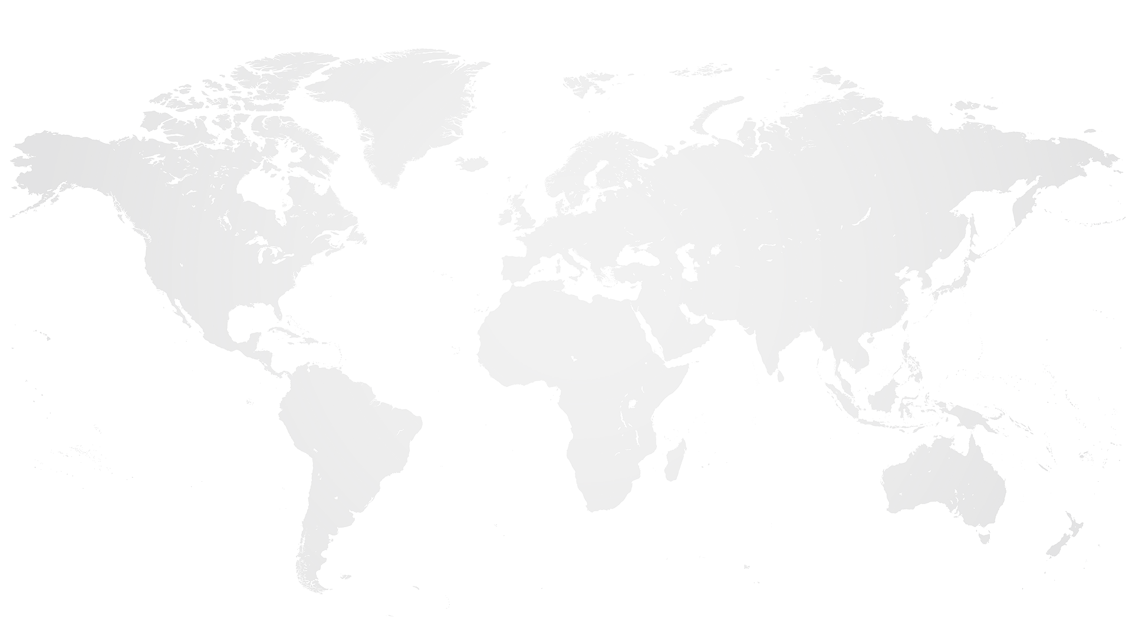





Module Communication
Registered
User
Local Storage
Location
New Data
Google Map
Registered
User
Existing Data
Amazon
MySQL DB
Login Register
Token
Notification
Location
Register
Registered
User
Firebase
Notification

Slide 12
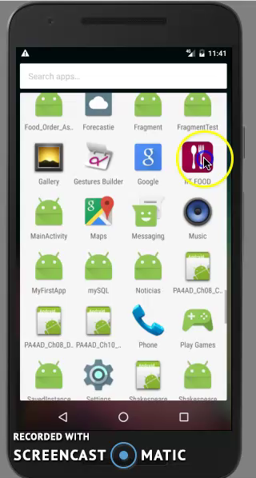
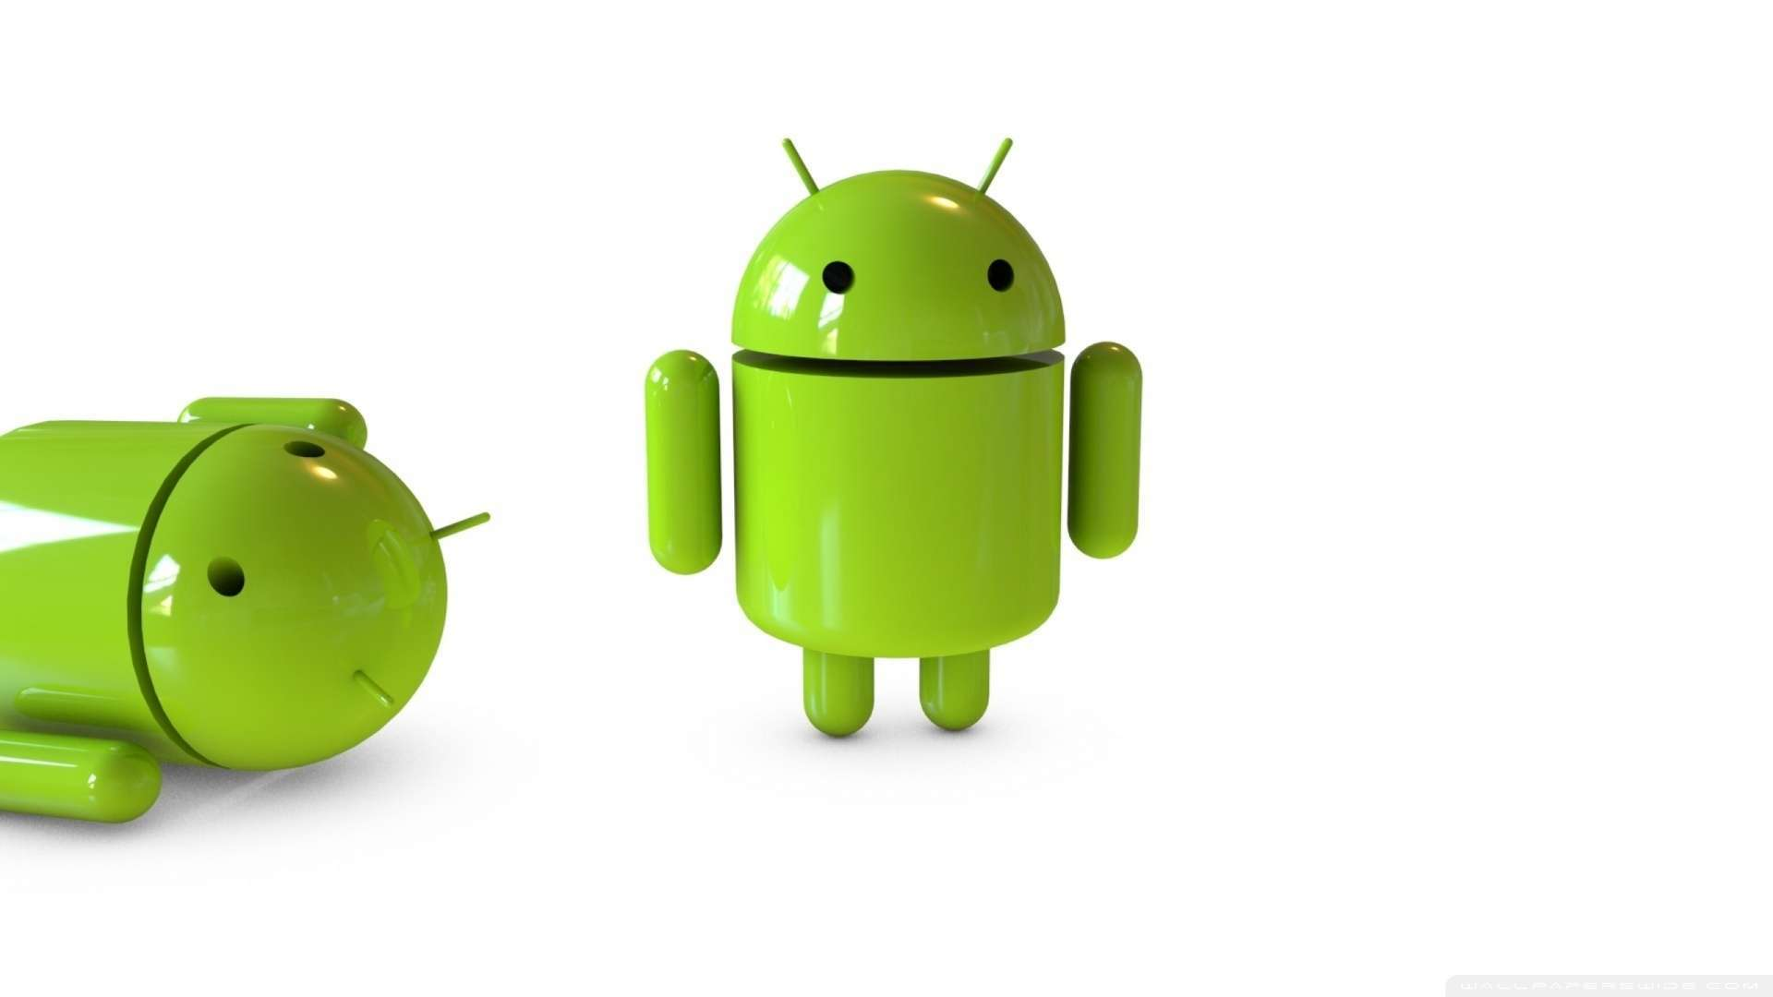
Animation
Animation
ViewFlipper

Slide 13
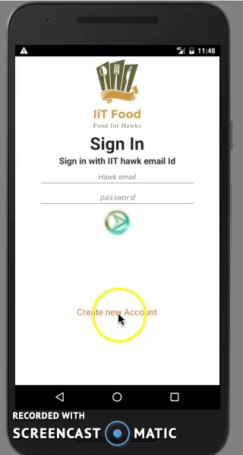
Fragment
Login
Register
Home

Slide 14
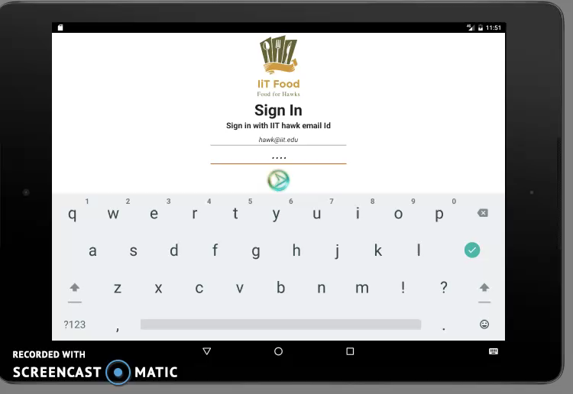
Tablet View

Slide 15
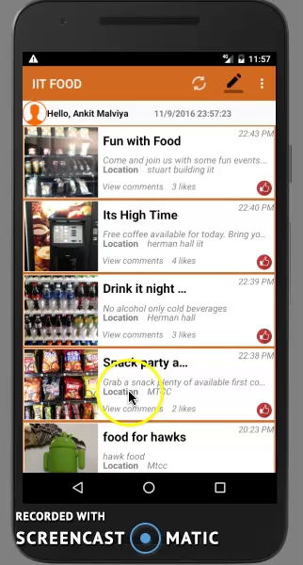
Detail View
Google Map

Slide 16
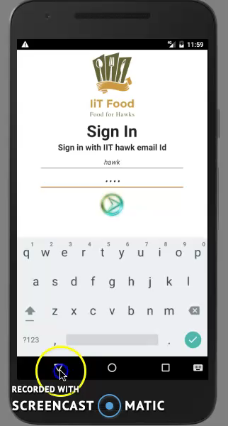
Validation
Snack Bar

